Slide 1
Logical Agents
Course Code: CSC4226
Course Title: Artificial Intelligence and Expert System
Dept. of Computer Science
Faculty of Science and Technology
Lecture No: | Eight (8) | Week No: | Nine (9) | Semester:
Lecturer: | Dr. Ashraf Uddin dr.ashraf@aiub.edu

Slide 2
Lecture Outline
Knowledge Based Agent
The Wumpus World
Logic
Propositional Logic
First-Order Logic
Inference in First-Order Logic

Slide 3
Big Idea
Drawing reasonable conclusions from a set of data (observations, beliefs, etc) seems key to intelligence
Logic is a powerful and well-developed approach to this and highly regarded by people
Logic is also a strong formal system that we can programs computers to use
Maybe we can reduce any AI problem to figuring out how to represent it in logic and apply standard proof techniques to generate solutions

Slide 4
Inference in People
People can do logical inference but are not very good at it.
Reasoning with negation and disjunction seems to be particularly difficult.
But people seem to employ many kinds of reasoning strategies, most of which are neither complete nor sound.

Slide 5
A knowledge-based agent
A knowledge-based agent includes a knowledge base and an inference system.
A knowledge base is a set of representations of facts of the world.
Each individual representation is called a sentence.
The sentences are expressed in a knowledge representation language.
The agent operates as follows:
1. It TELLs the knowledge base what it perceives.
2. It ASKs the knowledge base what action it should perform.
3. It performs the chosen action.

Slide 6
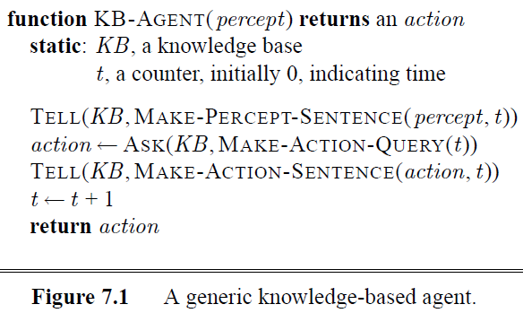
Generic KB Agent

Slide 7
Architecture of a KB agent
Knowledge Level
The most abstract level: describe agent by saying what it knows
Ex: A taxi agent might know that the Golden Gate Bridge connects San Francisco with the Marin County
Logical Level
The level at which the knowledge is encoded into sentences
Ex: links(GoldenGateBridge, SanFrancisco, MarinCounty)
Implementation Level
The physical representation of the sentences in the logical level
Ex: ‘(links goldengatebridge sanfrancisco marincounty)

Slide 8
Declarative Approach
Constructing KB by telling what it needs to know.
Knowledge Representation Language-
Make it easy to express the knowledge in the form of sentences,
[simplify the construction problem]
Learning Mechanism-
Output general knowledge about the environment
given a series of percept

Slide 9
The Wumpus World Environment
The Wumpus computer game
The agent explores a cave consisting of rooms connected by passageways
Lurking somewhere in the cave is the Wumpus, a beast that eats any agent that enters its room
Some rooms contain bottomless pits that trap any agent that wanders into the room
The Wumpus can fall into a pit too, so avoids them
Occasionally, there is a heap of gold in a room.
The goal is to collect the gold and exit the world without being eaten

Slide 10
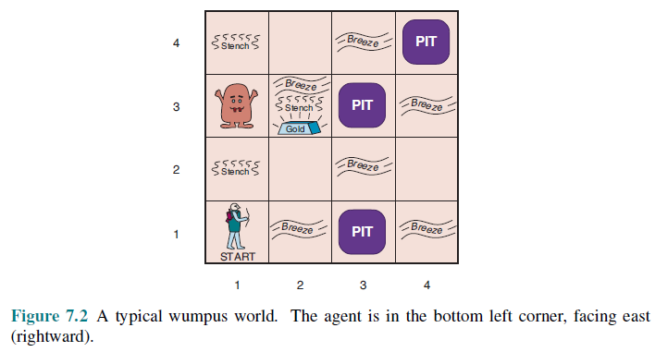
AIMA’s Wumpus World
The agent always starts in the field [1,1]
Agent’s task is to find the gold, return to the field [1,1] and climb out of the cave

Slide 11
Agent in a Wumpus world: Percepts
The agent perceives a stench in the square containing the Wumpus and in the adjacent squares (not diagonally) ,a breeze in the squares adjacent to a pit, a glitter in the square where the gold is, a bump, if it walks into a wall, a woeful scream everywhere in the cave, if the Wumpus is killed
The percepts are given as a five-symbol list. If there is a stench and a breeze, but no glitter, no bump, and no scream, the percept is [Stench, Breeze, None, None, None]
The agent cannot perceive its own location

Slide 12
Wumpus World: Actions
go forward
turn right 90 degrees
turn left 90 degrees
grab: Pick up an object that’s in the same square as the agent
shoot: Fire an arrow in a straight line in the direction the agent is facing. It continues until it hits and kills the Wumpus or hits the outer wall. The agent has only one arrow, so only the first shoot action has any effect
climb is used to leave the cave and is only effective in the start square
die: This action automatically and irretrievably happens if the agent enters a square with a pit or a live Wumpus

Slide 13
Wumpus World Goal
The agent’s goal is to find the gold and bring it back to the start square as quickly as possible, without getting killed
1,000 points reward for climbing out of the cave with the gold
1 point deducted for every action taken
10,000 points penalty for getting killed

Slide 14
Wumpus world characterization
Fully Observable No – only local perception
Deterministic Yes – outcomes exactly specified
Episodic No – sequential at the level of actions
Static Yes – Wumpus and Pits do not move
Discrete Yes
Single-agent? Yes – Wumpus is essentially a natural feature

Slide 15
AIMA’s Wumpus World
The agent always starts in the field [1,1]
Agent’s task is to find the gold, return to the field [1,1] and climb out of the cave

Slide 16
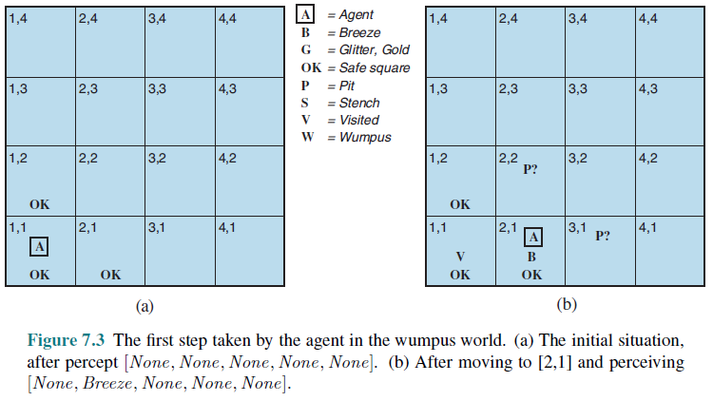
The Hunter’s first step

Slide 17
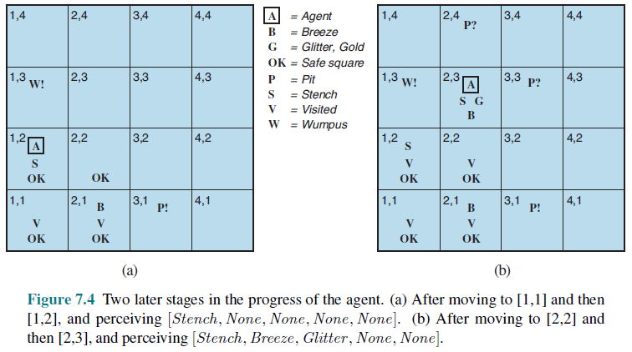
The Hunter’s Next step

Slide 18
Logic in general
Logics are formal languages for representing information such that conclusions can be drawn
Syntax defines the sentences in the language
Semantics define the "meaning" of sentences
i.e., define truth of a sentence in a world
E.g., the language of arithmetic
x+2 ≥ y is a sentence; x2+y > {} is not a sentence
x+2 ≥ y is true iff the number x+2 is no less than the number y
x+2 ≥ y is true in a world where x = 7, y = 1
x+2 ≥ y is false in a world where x = 0, y = 6

Slide 19
Entailment
Entailment means that one thing follows from another:
KB ╞ α
Knowledge base KB entails sentence α if and only if α is true in all worlds where KB is true
E.g., the KB containing “UMBC won” and “JHU won” entails “Either UMBC won or JHU won”
E.g., x+y = 4 entails 4 = x+y
Entailment is a relationship between sentences (i.e., syntax) that is based on semantics

Slide 20
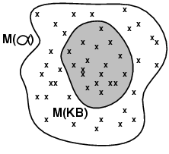
Models
Logicians typically think in terms of models, which are formally structured worlds with respect to which truth can be evaluated
We say m is a model of a sentence α if α is true in m
M(α) is the set of all models of α
Then KB ╞ α iff M(KB) ⊆ M(α)
KB = UMBC won and JHU won
α = UMBC won
Then KB ╞ α

Slide 21
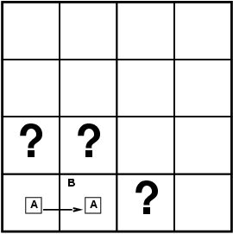
Entailment in the wumpus world
Situation after detecting nothing in [1,1], moving right, breeze in [2,1]
The agent is interested (among other things) in whether the adjacent squares [1,2], [2,2], and [3,1] contain pits.
Consider possible models for KB assuming only pits and restricting cells to {(1,2)(2,2)(3,1)}
8 possible models

Slide 22
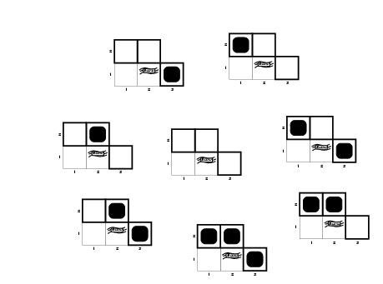
Wumpus models
Possible models for the presence of pits in squares [1,2], [2,2], and [3,1].

Slide 23
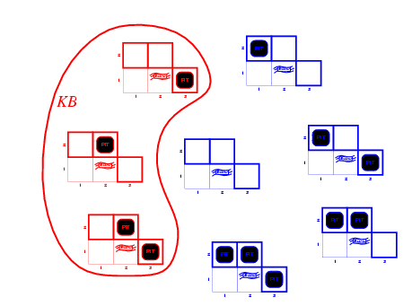
KB = world rules + observations
The KB corresponding to the observations of nothing in [1,1] and a breeze in [2,1] is shown by the solid line.

Slide 24
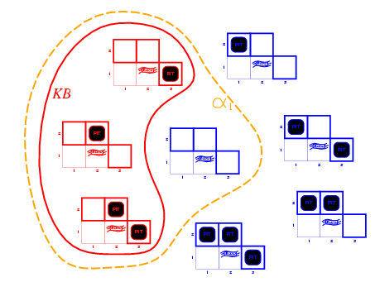
Wumpus models
KB = wumpus-world rules + observations
α₁ = “[1,2] is safe”
Since all models include α₁
KB ╞ α₁, proved by model checking
Dotted line shows models of α1 (no pit in [1,2]).

Slide 25
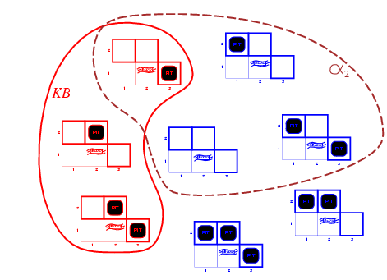
Wumpus models
Dotted line shows models of α2 (no pit in [2,2]).
KB = wumpus-world rules + observations
α₂ = "[2,2] is safe“
Since there are some models that don’t include α₂
KB ╞ α₂

Slide 26
Inference, Soundness, Completeness
KB ├_{i} α = sentence α can be derived from KB by procedure i
Soundness: i is sound if whenever KB ├_{i} α, it is also true that
KB╞ α
Completeness: i is complete if whenever KB╞ α, it is also true that KB ├_{i} α
Preview: we will define a logic (first-order logic) which is expressive enough to say almost anything of interest, and for which there exists a sound and complete inference procedure. That is, the procedure will answer any question whose answer follows from what is known by the KB.

Slide 27
Representation, reasoning, and logic
The object of knowledge representation is to express knowledge in a computer-tractable form, so that agents can perform well
A knowledge representation language is defined by:
its syntax, which defines all possible sequences of symbols that constitute sentences of the language.
Ex: Sentences in a book, bit patterns in computer memory
its semantics, which determines the facts in the world to which the sentences refer.
Each sentence makes a claim about the world.
An agent is said to believe a sentence about the world.

Slide 28
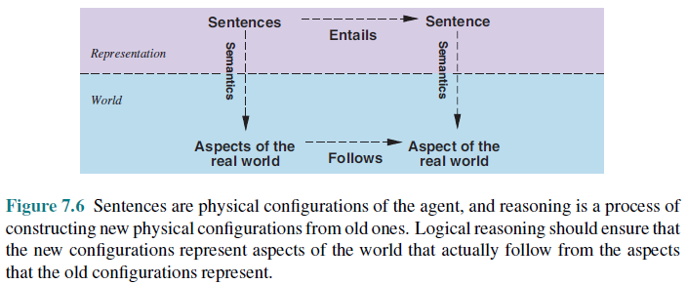
The connection between sentences and facts

Slide 29
Soundness and completeness
A sound inference method derives only entailed sentences
Analogous to the property of completeness in search, a complete inference method can derive any sentence that is entailed

Slide 30
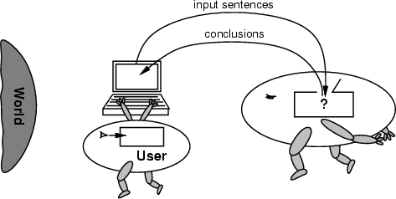
Soundness is important
The reasoning agent often gets its knowledge about the facts of the world as a sequence of logical sentences and must draw conclusions only from them without independent access to the world.
Thus, it is very important that the agent’s reasoning is sound!

Slide 31
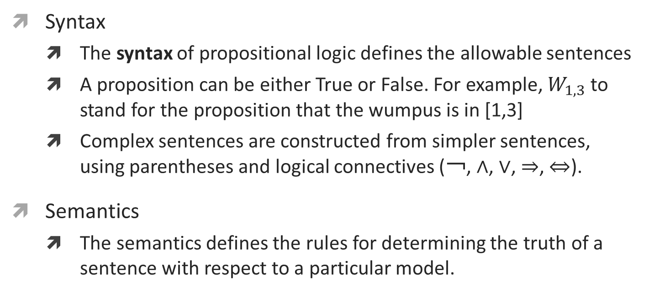
Propositional Logic
Syntax
The syntax of propositional logic defines the allowable sentences
A proposition can be either True or False. For example, $W_{1,3}$ to stand for the proposition that the wumpus is in [1,3]
Complex sentences are constructed from simpler sentences, using parentheses and logical connectives (￢, ∧, ∨, ⇒, ⇔).
Semantics
The semantics defines the rules for determining the truth of a sentence with respect to a particular model.

Slide 32
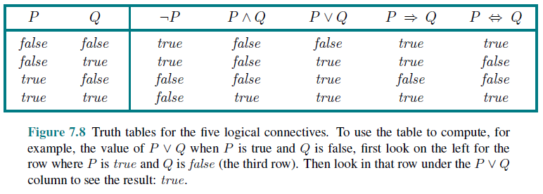
Propositional Logic

Slide 33
Propositional Logic
Semantics
For example, a square is breezy if a neighboring square has a pit, and a square is breezy only if a neighboring square has a pit. So we need a biconditional,
B1,1 ⇔ (P1,2 ∨ P2,1) ,

Slide 34
Wumpus Knowledge Base
Px,y is true if there is a pit in [x, y].
Wx,y is true if there is a wumpus in [x, y], dead or alive.
Bx,y is true if the agent perceives a breeze in [x, y].
Sx,y is true if the agent perceives a stench in [x, y].

Slide 35
Inference using PL: Example
The sentences we write will suffice to derive ￢P1,2 (there is no pit in [1,2]), as was done informally in Section 7.3. We label each sentence Ri so that we can refer to them:
• There is no pit in [1,1]:
R1 : ￢P1,1
• A square is breezy if and only if there is a pit in a neighboring square. This has to be
stated for each square; for now, we include just the relevant squares:
R2 : B1,1 ⇔ (P1,2 ∨ P2,1) .
R3 : B2,1 ⇔ (P1,1 ∨ P2,2 ∨ P3,1) .
• The preceding sentences are true in all wumpus worlds. Now we include the breeze percepts for the first two squares visited in the specific world the agent is in, leading up
R4 : ￢B1,1 .
R5 : B2,1 .

Slide 36
Inference using PL: Example
Let us see how these inference rules and equivalences can be used in the wumpus world. We start with the knowledge base containing R1 through R5 and show how to prove ￢P1,2, that is, there is no pit in [1,2].
First, we apply biconditional elimination to R2 to obtain
R6 : (B1,1 ⇒ (P1,2 ∨ P2,1)) ∧ ((P1,2 ∨ P2,1) ⇒ B1,1) .
Then we apply And-Elimination to R6 to obtain
R7 : ((P1,2 ∨ P2,1) ⇒ B1,1) .
Logical equivalence for contrapositives gives
R8 : (￢B1,1 ⇒ ￢(P1,2 ∨ P2,1)) .
Now we can apply Modus Ponens with R8 and the percept R4 (i.e., ￢B1,1), to obtain
R9 : ￢(P1,2 ∨ P2,1) .
Finally, we apply De Morgan’s rule, giving the conclusion
R10 : ￢P1,2 ∧ ￢P2,1 .
That is, neither [1,2] nor [2,1] contains a pit.

Slide 37
Summary
Intelligent agents need knowledge about the world for making good decisions.
The knowledge of an agent is stored in a knowledge base (KB) in the form of sentences in a knowledge representation (KR) language.
A knowledge-based agent needs a KB and an inference mechanism. It operates by storing sentences in its knowledge base, inferring new sentences with the inference mechanism, and using them to deduce which actions to take.
A representation language is defined by its syntax and semantics, which specify the structure of sentences and how they relate to the facts of the world.
The interpretation of a sentence is the fact to which it refers. If the fact is part of the actual world, then the sentence is true.

Slide 38
References
Chapter 7: Logical Agents , Pages 234-244 “Artificial Intelligence: A Modern Approach,” by Stuart J. Russell and Peter Norvig,
Chapter 8: First Order Logic , Pages 285-295 “Artificial Intelligence: A Modern Approach,” by Stuart J. Russell and Peter Norvig,
http://scv.bu.edu/cgi-bin/wcl – Web-based version you can play
http://codenautics.com/wumpus/ - Mac version

Slide 39
Books
“Artificial Intelligence: A Modern Approach,” by Stuart J. Russell and Peter Norvig.
"Artificial Intelligence: Structures and Strategies for Complex Problem Solving", by George F. Luger, (2002)
"Artificial Intelligence: Theory and Practice", by Thomas Dean.
"AI: A New Synthesis", by Nils J. Nilsson.
“Programming for machine learning,” by J. Ross Quinlan,
“Neural Computing Theory and Practice,” by Philip D. Wasserman, .
“Neural Network Design,” by Martin T. Hagan, Howard B. Demuth, Mark H. Beale, .
“Practical Genetic Algorithms,” by Randy L. Haupt and Sue Ellen Haupt.
“Genetic Algorithms in Search, optimization and Machine learning,” by David E. Goldberg.
"Computational Intelligence: A Logical Approach", by David Poole, Alan Mackworth, and Randy Goebel.
“Introduction to Turbo Prolog”, by Carl Townsend.

